Slide 1



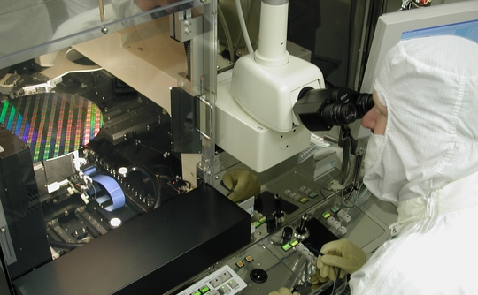
Moore’s Law continuing for 10+ years
UC Berkeley EECS Teaching Professor Dan Garcia
The Beauty and Joy of Computing Lecture #20
Besides Blocks II:
Python Data Structures & APIs
Approaching the 50th anniversary of Moore’s Law declaration, engineers at Intel declared they don’t see Moore’s law slowing for another 10 years! They are working on 7nm and 5nm processes (the width between wires). One thing that will help is 3D stacking of components; heat is ever an issue!
www.v3.co.uk/v3-uk/news/2403113/intel-predicts-moores-law-to-last-another-10-years

Slide 2
(Cal) Admin Notes
Final Projects start this week!
Use Snap! or Python
Individual
3 weeks to work
Milestone at 7.5 hours with submission
Schedule (see website)

Slide 3
(Cal) Lecture Overview
Data Structures
Sequences
String
List
Tuple
Range
Dictionaries
Higher-Order Functions
APIs

Slide 4
Python Objects & Sequences

Slide 5
Python … everything is an object!
Just like OOP from Programming paradigms…
Importing a class/module that isn’t built-in:
import <module>
E.g., import math
Getting help
help(<type>) or help(<value>) or help(<module>)
E.g., help(int) or help(1) or help(math)
Calling
<module/object>.<function>(<args>, …) or <module>.<constant> or <object>.<field>
E.g., “12”.isdigit() or math.pi or (1+2j).real

Slide 6
Python Sequences
Contain an ORDERED set of data
str – “text in quotes” (Snap! sentence)
list – [‘a’, ‘group’ , ‘of’, ‘items’]
tuple – (‘a’, ‘group’, ‘of’, ‘items’)
a list that can’t be modified
range(start, stop, step) – sequence of #s
Supports very easy iteration:
for item in sequence:
print(item)

Slide 7
Python Sequence (general) Operations
elem in & not in sequence
+ & *
my_sequence[START:END:STEP]
len()
min() & max()
Even map() filter() & reduce()!
count(item)
Many, many more: http://docs.python.org/library/stdtypes.html#typesseq
☑

Slide 8
Python Strings, Lists, Tuples & Ranges

Slide 9
Python Strings
Sequence (or “list” or “array”) of chars
Quoting
Single Quotes, Double Quotes
Triple Quotes (this keeps formatting and line breaks)
Concentration, finding length, etc.
help(str) and help(“string”)
http://docs.python.org/library/stdtypes.html#string-methods

Slide 10
Python Lists
Collection of any type
Including itself!
Indexing (mylist[item])
Indexed from 0, NOT 1, unlike Snap!
Modifying (my_list[item] = new_item)
Slicing and slicing notation (i.e. [::])
Exactly the same as string notation!
Operators
append(x), insert(i,x), count(x), sort(), etc.
http://docs.python.org/library/stdtypes.html#mutable-sequence-types

Slide 11
Python Tuples & Ranges
Tuples mostly like Lists except () not []
Except they can’t be changed (like strings)
This immutability will be helpful in dictionaries
Ranges are virtual sequences of #s
Useful and fast
They don’t actually exist until you need them
Use list(range(<args>)) to see it
Would be nice to have this available in Snap!
Demo! ☑

Slide 12

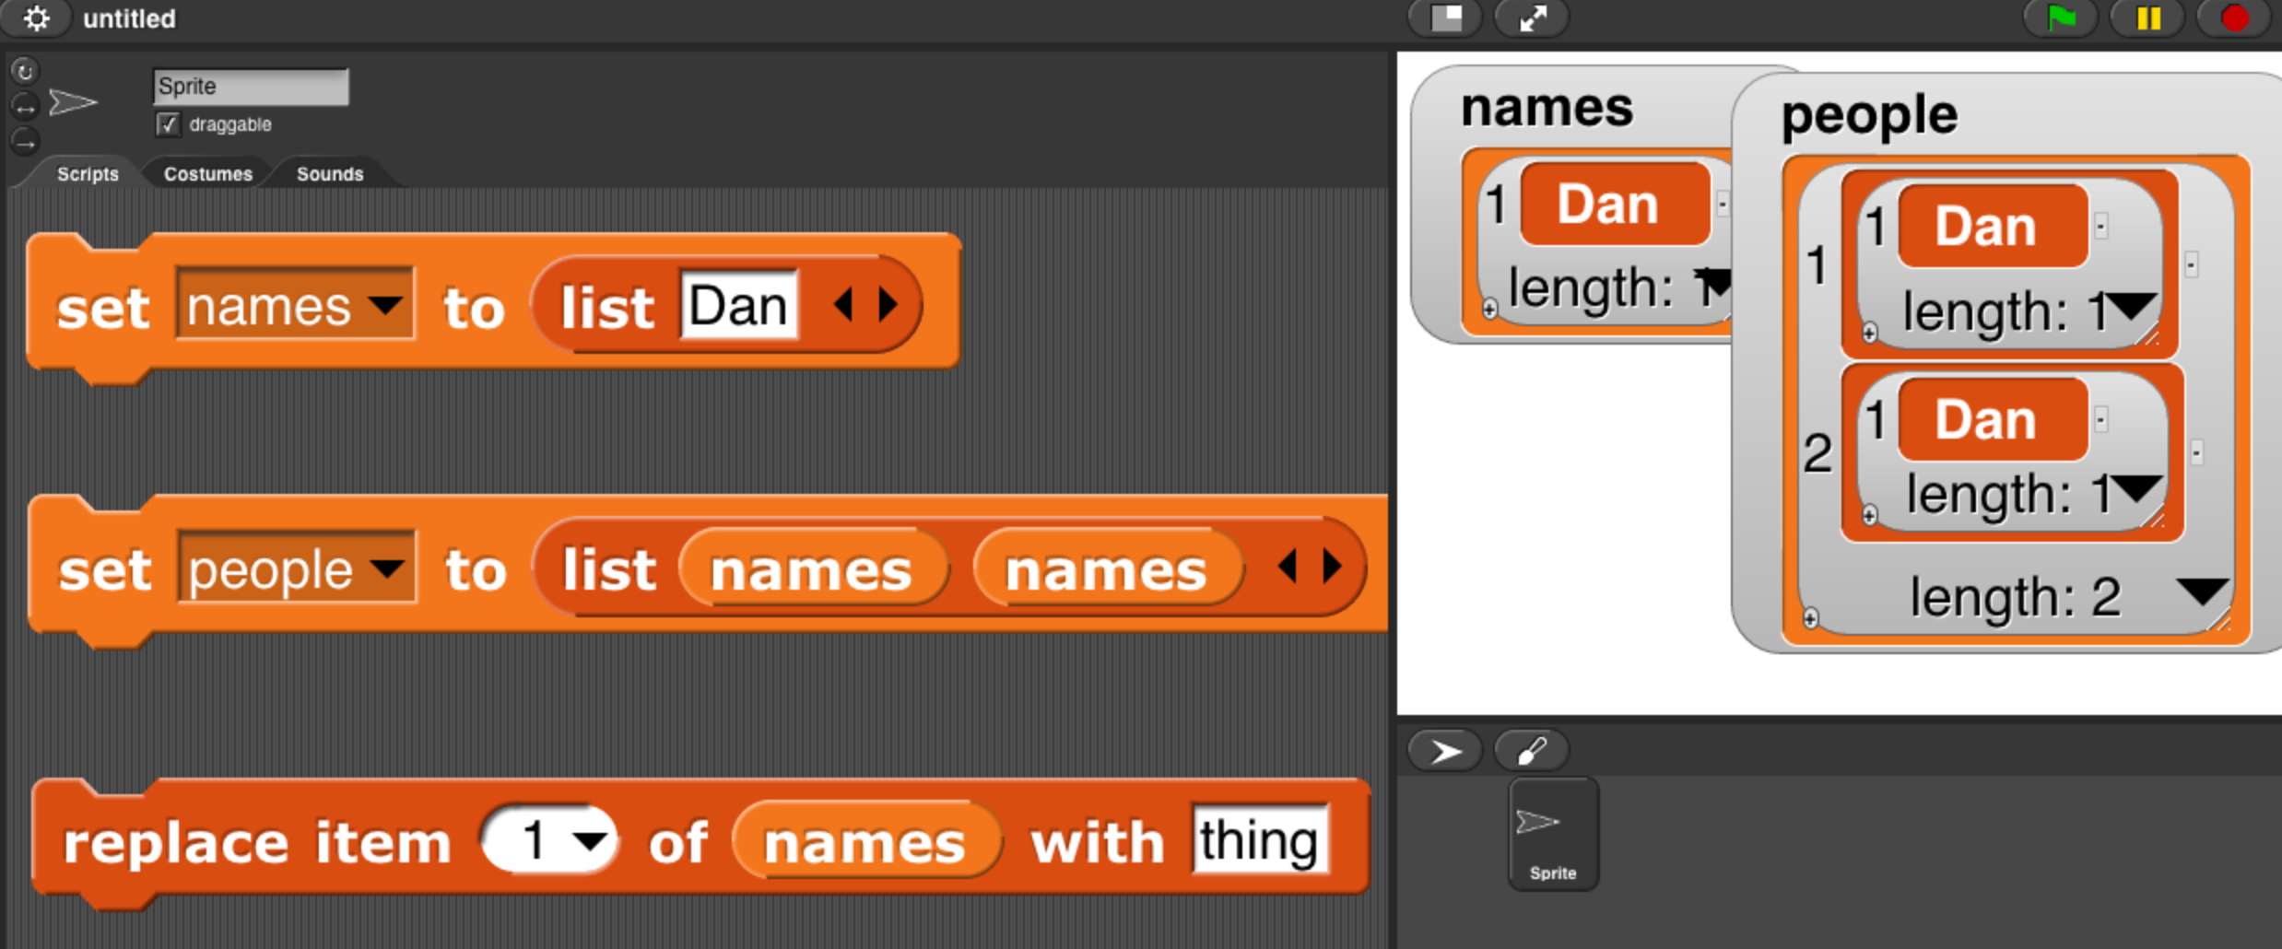
(Cal) Clicker Question
What is people after clicking the “replace” command?
((Dan) (Dan))
((Dan) (thing))
((thing) (Dan))
((thing) (thing))
Error
Notes:
Data and information is hard to define. There are philosophical and meta-physical issues. So let’s all watch the Matrix…

Slide 13
(Cal) Clicker Question
What is people after clicking the “replace” command?
[[“Dan”], [“Dan”]]
[[“Dan”], [“thing”]]
[[“thing”], [“Dan”]]
[[“thing”], [“thing”]]
Error
>>> names = [“Dan”]
>>> people = [names, names]
>>> people
[['Dan'], ['Dan']]
>>> names[0] = “thing”
Notes:
Data and information is hard to define. There are philosophical and meta-physical issues. So let’s all watch the Matrix…

Slide 14
Python Dictionaries

Slide 15
Python Dictionaries (dict)
Very fast access (by key, not number)
“Map” from a key to a value
Syntax
{ key1 : value1, key2 : value2, … }
Adding elements
dict[key] = value
Accessing elements (just like sequences):
dict[key]
Keys
Looking for specific keys (“in”)
Iterating over (iterkeys())
Demo! ☑

Slide 16
(Cal) Clicker Question
We saw a series of “is a particular student here” problems when the students were unsorted, sorted, & given-months-in-advance. What running time did a dictionary-like structure help us attain?
Exponential
Quadratic
Linear
Logarithmic
Constant
Notes:
Data and information is hard to define. There are philosophical and meta-physical issues. So let’s all watch the Matrix…

Slide 17
Python HOFs & APIs

Slide 18
Python APIs
“Application Programming Interface”
Set of agreements for sharing information
Programming APIs (i.e., how to use modules)
E.g., Building Blocks for common elements such as Open or Save prompts
Web APIs
“Special” URLs for accessing data directly
Example: Jeopardy API
http://jservice.io/api/random
Example: Solved Game APIs (e.g., Tic Tac Toe)
getNextMoveValues

Slide 19
Demo (reference)
Code files are all on the website
hof.py
Some Higher Order Functions in Python we’ve seen in Snap!
fractals.py
Some fractals in Turtle Graphics
jeopardyAPI.py
Standalone text-based Jeopardy game
tttAPI.py
Tic-Tac-Toe in Python
Games Crafters API for information about best moves

Slide 20
More Information
Online Python Tutor (invaluable!!)
http://www.pythontutor.com/
Sequences & Methods
http://docs.python.org/library/stdtypes.html
Coding Bat (Great practice!)
http://codingbat.com/python
Google’s Python Class
http://code.google.com/edu/languages/google-python-class/
Exercises (More practice!)
http://code.google.com/edu/languages/google-python-class/exercises/basic.html

